Slide 1

Hackathon 2020 Workshop 2: Webdev
Luo Wenqiang
Video Analytics
Data Science & Artificial Intelligence Division
2020

Slide 2
Outline
Key concepts in modern web app
React
Tool stack: NPM, Webpack
Backend integration
Summary

Slide 3
Key Concepts in Modern Web App

Slide 4
Fundamentals
HTML5, CSS, SVG
flex box
optional: Meta-CSS, like LESS, SASS, …
JavaScript:
AJAX
jQuery
ES6: class, ()={}, let, const, for ... of, async/await, …
optional: TypeScript
Multi-page site/app >> single-page app
more friendly to the user: no page flashing/waiting;
more challenging to the developer
easier to maintain states across sub-pages;

Slide 5
CSS Frameworks
≠ CSS Preprocessors (like LESS, SASS, …)
CSS FW: a curated set of common UI styles and widgets
Why CSS framework?
poor-man’s design wizard
establish some good CSS convention and practices
Popular options:
Bootstrap
https://react-bootstrap.github.io/
Material UI
SVG icons: https://materialdesignicons.com/
Semantic UI, …
Compatibility with Adobe XD or Sketch? not sure

Slide 6
Reactive vs. Responsive
Responsive (design):
making your UI/UX adaptive to different devices
e.g. screen size, mouse vs. touch screen, …
styling: handled by CSS, interaction: JS
Reactive?

Slide 7
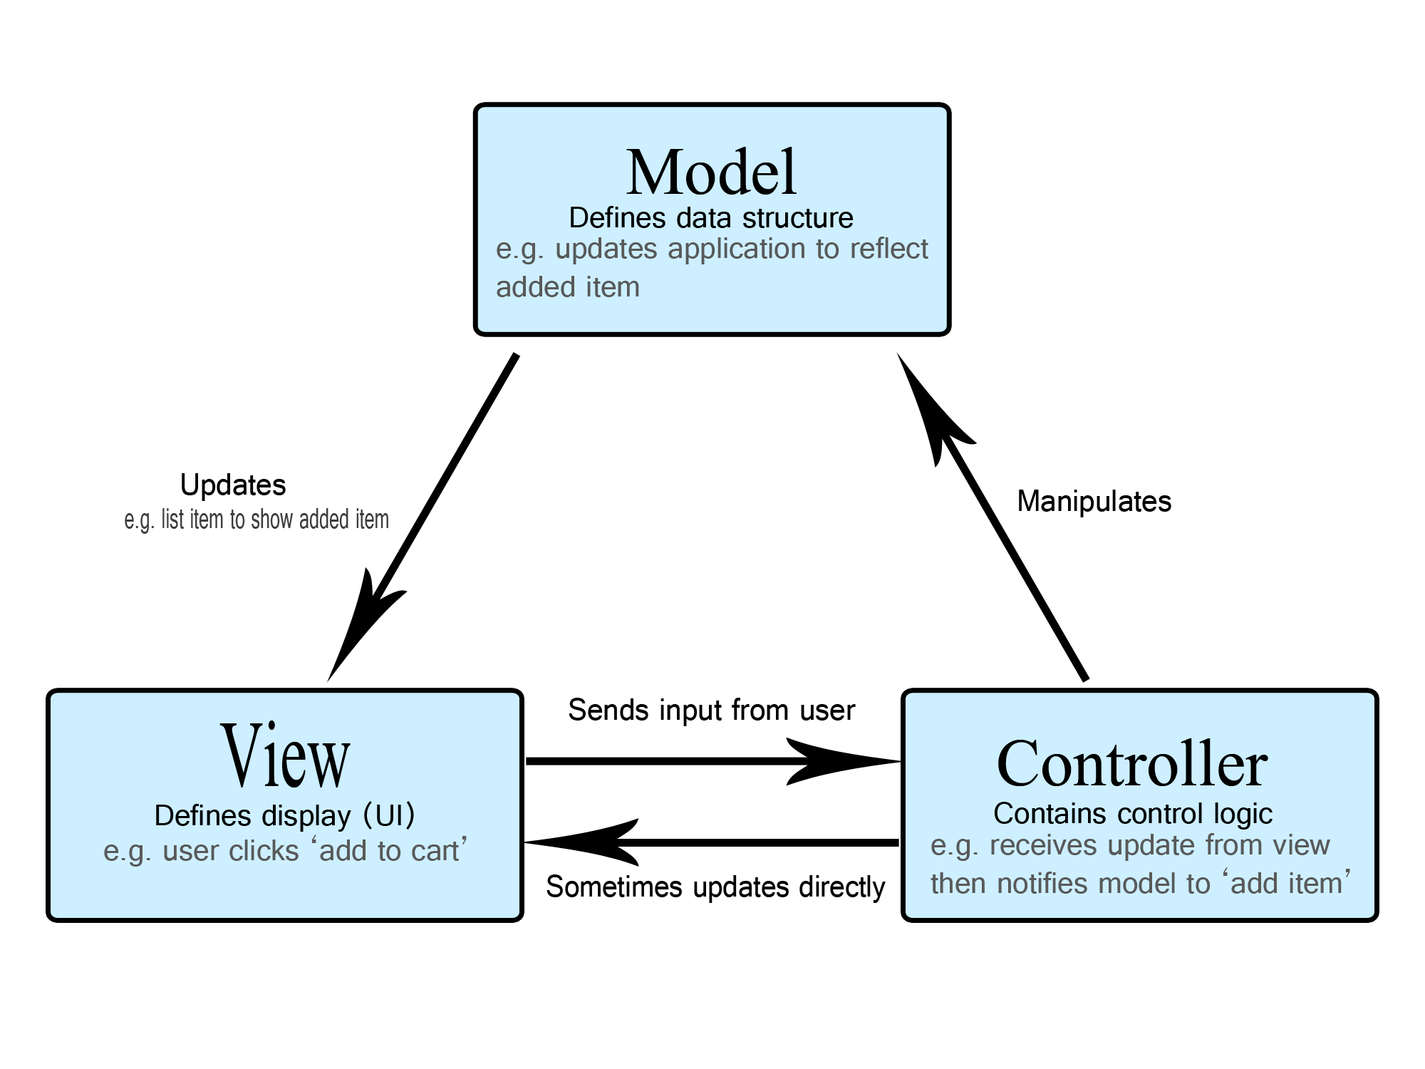
MVC Pattern
Legacy UI app pattern: including jQuery

Slide 8
Reactive MVC Pattern
X
View updating is completely handled by the MVC framework

Slide 9
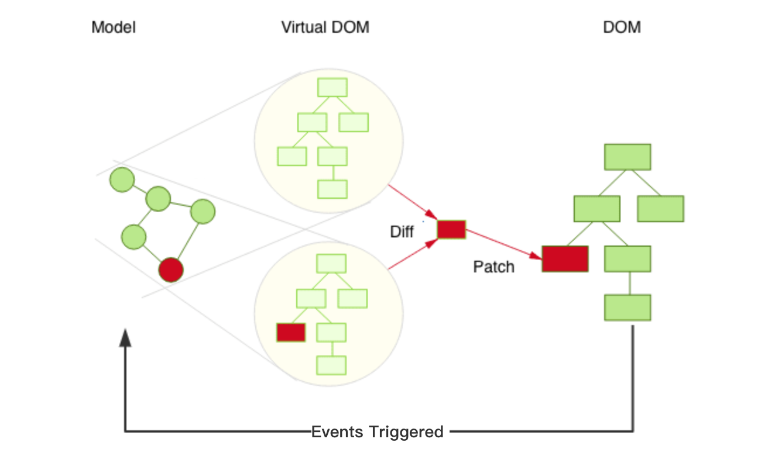
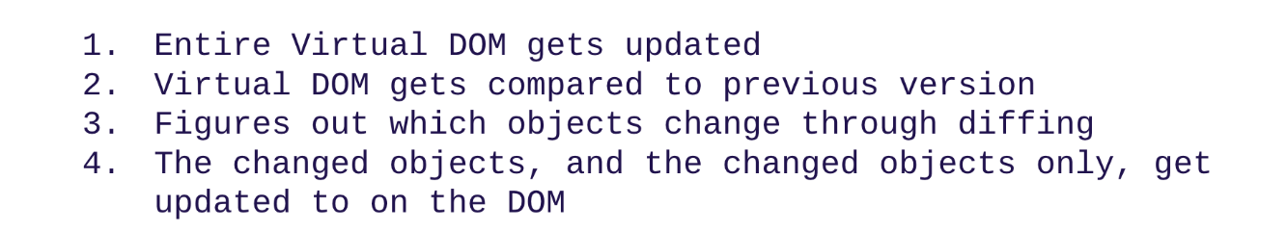
Virtual DOM

Slide 10
Benefits of Reactive UI
Application code (esp. controller) is much simpler
Easier to integrate and reuse components and widgets
Better performance
minimized DOM changes;
Server-side rendering;

Slide 11
React

Slide 12
Why React?
Angular is the first responsive UI framework;
React: the first virtual-DOM based UI framework;
most active community and eco-system;
easy to find tutorials, components, …

Slide 13
React Template - JSX
HTML | JSX
<div>, <DIV> | <div> - HTML, <Div> component
<div class=‘heading’>…</div> | <div className=‘heading’>…</div>
<div style=‘width:100px; height:80px’>…</div> | <div style={{width:’100px’, height:’80px’}}>…</div>
<div onclick=‘…’>…</div> | <div onClick={…}>…</div>
<!-- comment --> | {/* comment */}
JSX | Compiled JS
const element = ( <h1 className="greeting"> Hello, world! </h1> ); | const element = React.createElement( 'h1', {className: 'greeting'}, 'Hello, world!' );

Slide 14
React Components
3 flavours:
Pure functional components;
Class based components;
Hook based components;

Slide 15
State Management
setState()
useState
state frameworks:
Redux
MobX
…

Slide 16
Component Lifecycle
componentDidMount(), componentWillUnmount()
for DOM specific logic:
size, position related
timer, etc.
canvas
for integrating with legacy jQuery components/libraries;

Slide 17
Tool Stack

Slide 18
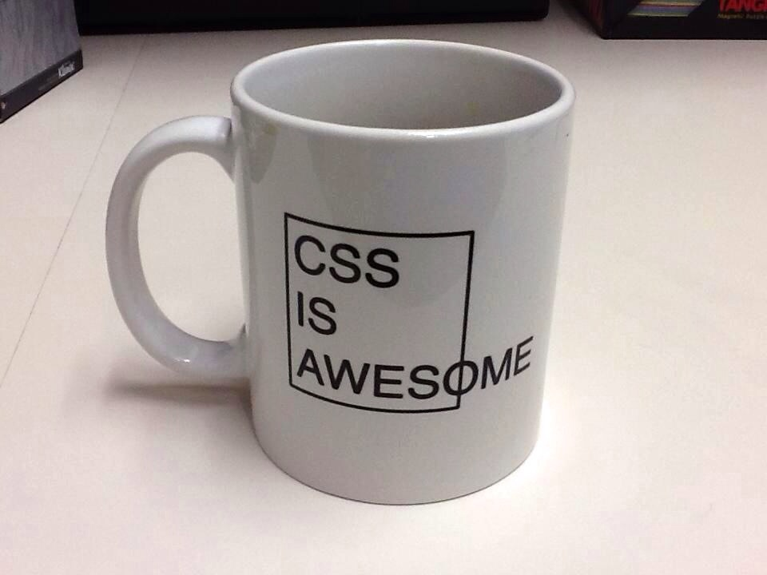
Tool Stack
Browser devtool:
stethoscope for front end developer;
DOM/CSS inspector;
Console;
JS debugger;
VS Code;
Git/GitHub;

Slide 19
NPM
NPM script
npm install, …
npm run … # custom cmdlets
optional: Gulp, Grunt, …

Slide 20
Webpack
the most ugly part of front-end dev
whitebox become blackbox;
why packing?
transpiling: JSX, latest JS features;
CSS preprocessing;
bundling, minification;
devserver and hot reload;
don’t use skeleton generator
create-react-app, Yeoman
Minifying

Slide 21
Back End Integration

Slide 22
Back End Integration
Micro-services: any lang
web backend: Node
ASP, JSP, PHP, Ruby, Python
assets (HTML, CSS, SVG, web fonts, images) mgt. and preprocessing;
component: server-side rendering;
same tool stack with frontend:
more code reuse, faster turnaround;

Slide 23
API Flavours
SOAP/XML
REST
Micro-services
IPC/gRPC, WebRTC/socket: two-way comm.
GraphQL: some interesting concept

Slide 24
Summary

Slide 25
Summary
Web app dev has a very fast evolving landscape
both front end and back end;
Don’t be bogged down by the changing tool chains and frameworks
HTML/CSS/SVG/JS are your fundamentals
Stay with the mainstream
Use what is comfortable to you, and build up progressively
Use something that you have reasonably good understanding
don’t use it for the sake of being hot
don’t blindly copy from tutorials and sample code;

Slide 26
Beyond Web App
Electron: desktop app;
Slack, Whatsapp, etc.;
true serverless dev environment:
fast prototyping without worrying about the infrastructure;
vs. browser + node
IPC vs. REST;
Electron: can distribute as desktop app;
browser + node: easier to Dockerize;:
Cordova: hybrid mobile app;
React Native: native mobile app;

Slide 27
Q & A

